Slide 1
CHRONIC SUPPURATIVE OTITIS MEDIA ( CSOM )
Dr. Prathana seles
Senior Resident
Department of ENT
TMCH

Slide 2
DEFINITION OF CSOM
Chronic suppurative otitis media is a long standing infection of a part or whole of the middle ear cleft characterized by continuous or intermittent discharge through a persistent tympanic membrane perforation.

Slide 3
CSOM is the chronic infection of the middle ear mucosa lining the middle ear cleft
The duration of infection should be more than 3 weeks
Middle ear cleft includes eustachian tube, middle ear proper and mastoid air cell system

Slide 9
It does not cause any serious complications
Infection limited to the antero inferior part of middle ear cleft
Associated with a central perforation

Slide 10
Why is Tubotympanic disease safe ?
There is no risk of bone erosion
Not known to cause intracranial complications
Discharge from middle ear flows freely through the perforation in the pars tensa
Usually the perforation of pars tensa is surrounded by rim of intact ear drum
The annulus is intact in all these cases

Slide 16
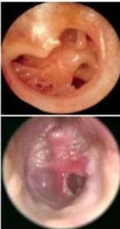
TYPES OF PERFORATION
CENTRAL PERFORATION:
Perforation in the pars tensa surrounded by pars tensa all around
MARGINAL PERFORATION :
Perforation in the pars tensa surrounded partly by pars tensa and partly by bone

Slide 17
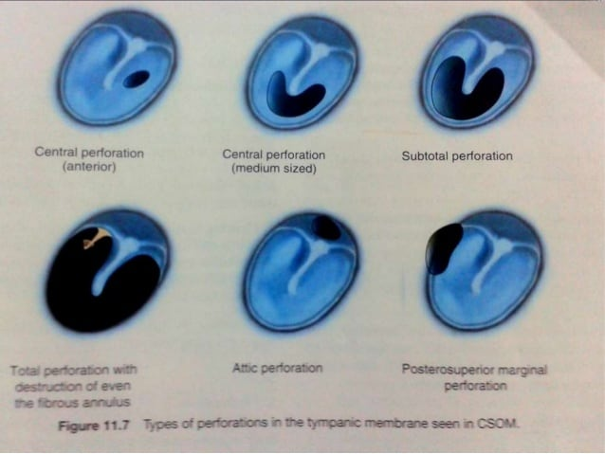

Slide 21
Retraction of tympanic membrane

Slide 29
TUNING FORK TESTS
RINNE NEGATIVE ON THE AFFECTED EAR ( BC > AC )
WEBER LATERALIZED TO DEAF EAR
ABC – NOT REDUCED

Slide 30
STAGES OF TUBOTYMPANIC DISEASE
ACUTE / ACTIVE STAGE
INACTIVE STAGE
QUIESCENT STAGE
HEALED STAGE

Slide 31
ACUTE / ACTIVE STAGE
Ear is actively discharging
Middle ear mucosa is hypertrophied and congested
The ear discharge is mucopurulent
Discharge is not foul smelling

Slide 32
INACTIVE STAGE
Dry perforation of ear drum +
Perforation involves the pars tensa
Annulus is intact
Middle ear mucosa is normal and healthy

Slide 33
QUIESCENT STAGE
Perforation of ear drum +
Middle ear is dry
Middle ear mucosa may be normal / hypertrophied
Discharge stopped jus a few days back

Slide 34
HEALED STAGE
Healing of drum by thin scar
Tympanosclerotic patches may be seen
Ossicular chain invariably intact

Slide 39
PURE TONE AUDIOMETRY
Shows conductive hearing loss
Hearing loss commonly ranges between 30-40 dB
If hearing exceeds 50 dB then ossicular chain disruption should be suspected
Associated sensorineural loss should arouse suspicion of toxic deafness

Slide 40
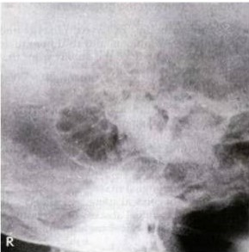
X-ray both mastoids
Pneumatisation of mastoid air cells
Haziness / clouding of air cells
Low lying tegmen or anteriorly lying sinus plate

Slide 42
ROUTINE INVESTIGATIONS
Complete hemogram : Hb , TC , DC , BT , CT , ESR
PT , INR
Random blood sugar
RFT- Blood urea , serum creatinine
Urine routine
Blood grouping and typing
ECG
X-RAY chest PA view

Slide 50
CAUSES OF FAILURE OF MEDICAL TREATMENT
Poor drainage of inflammatory exudate from the middle ear
Presence of persistent osteitis with mastoid granulation
Virulent and resistant organisms
Reinfection via Eustachian tube- adenoid, sinuses
Allergy
Mastoid reservoir

Slide 51
CHEMICAL CAUTERIZATION (MEDICAL MYRINGOPLASTY)
TRICHLOROACETIC ACID
Principle: the epithelium covering the margin of perforation is destroyed and exposing the fibroblasts
Mild irritations induces hyperemia and secondary fibroblast proliferations
Used in dry small to medium perforations
Several sittings may be necessary

Slide 74
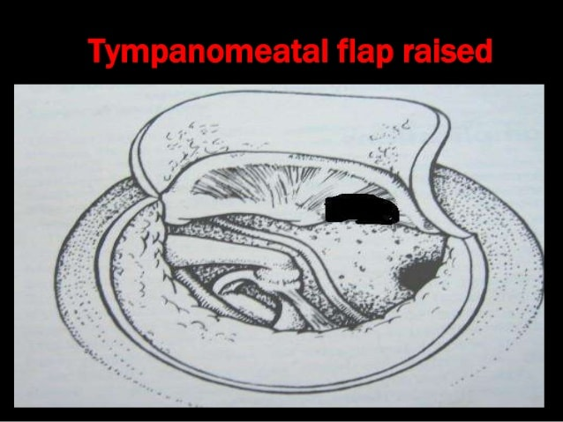

Slide 80
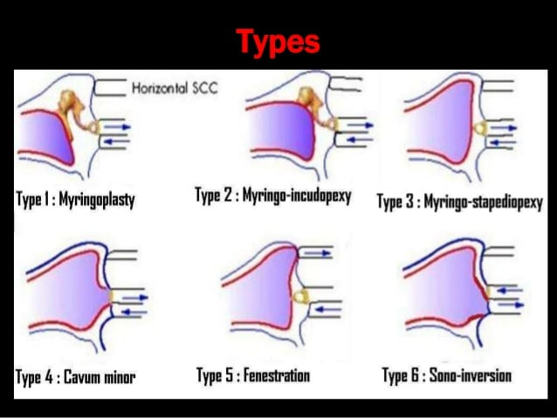

Slide 82
THANK YOU

